Slide 1

FAKE NEWS CLASSIFIER
By- prince aggarwal

Slide 2
Problem statement :
The authenticity of Information has become a longstanding issue affecting businesses and society, both for printed and digital media. On social networks, the reach and effects of information spread occur at such a fast pace and so amplified that distorted, inaccurate, or false information acquires a tremendous potential to cause real-world impacts, within minutes, for millions of users. Recently, several public concerns about this problem and some approaches to mitigate the problem were expressed.
In this project, using various model we must build a model which able to predict whether the news is real or fake.

Slide 3

Life cycle :

Slide 4
Data Description
There are 6 columns in the dataset provided to you. The description of each of the column is given below:
“id”: Unique id of each news article
“headline”: It is the title of the news.
“news”: It contains the full text of the news article
“Unnamed:0”: It is a serial number
“written_by”: It represents the author of the news article
“label”: It tells whether the news is fake (1) or not fake (0).

Slide 5
Data Cleaning
For Data Cleaning, there are features in the dataset “unnamed:0” which are not playing an important role for the model building, so they are removed them from the dataset.
There are some null values in the dataset in columns “headlines”, ”news” and “written_by”
“written_by column is not playing important role in this process and contains null values therefore it is removed
Null values are dropped as they were very small in range as compared to dataset
Also, while doing text pre-processing, I used TFIDF vectorizer.
While using word embedding, every news of a row does not follow same length

Slide 6
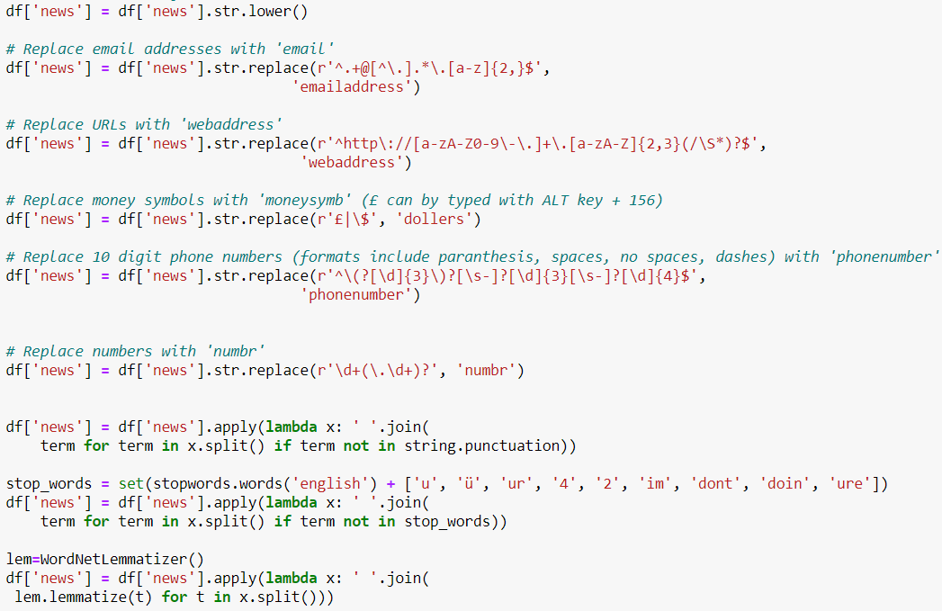
Data pre-processing
“News” column is the column which we have to work upon to classify them as fake or not fake
Therefore, data pre-processing is done using below techniques:

Slide 7
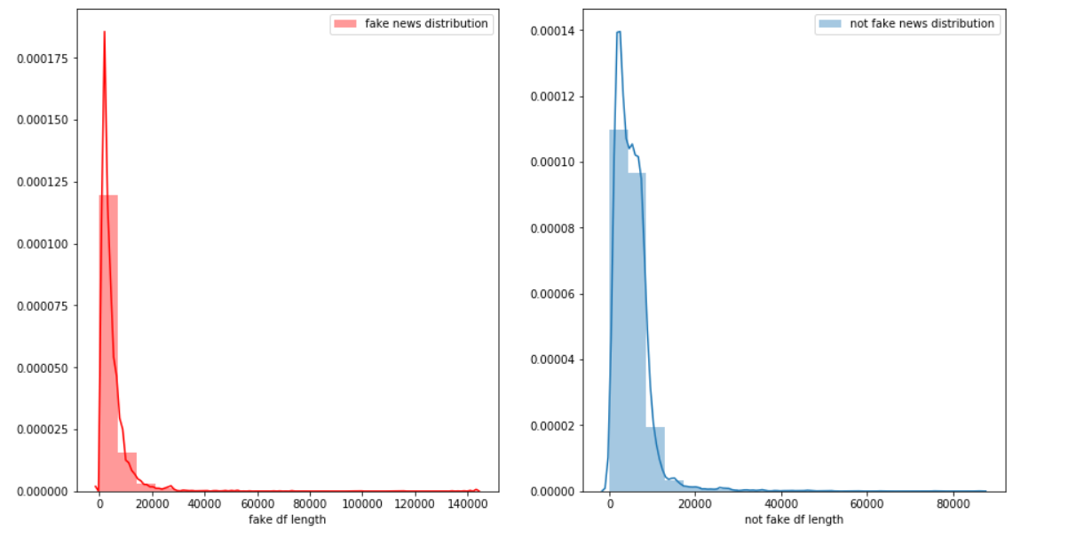
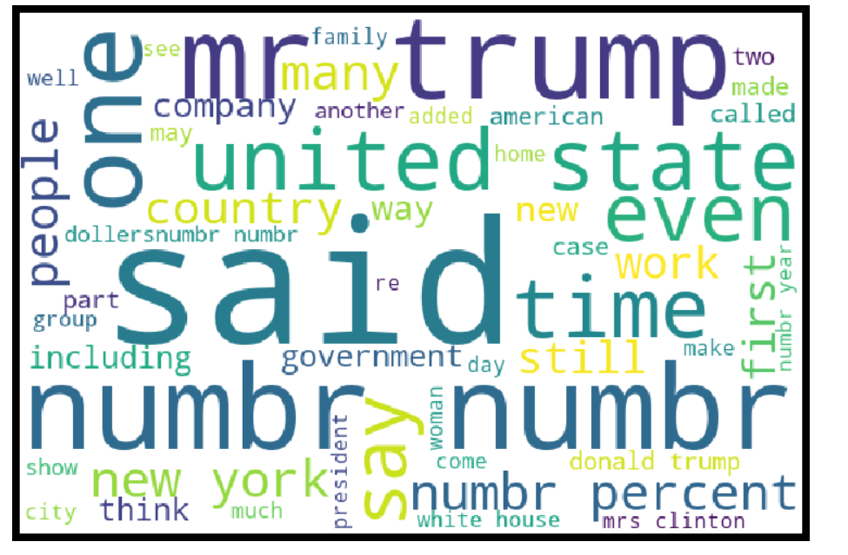
EDA
Above is the fake news and not fake news length distribution which is quite similar
Aside is the word-cloud made for an EDA

Slide 8
Model building:
Hyper parameter Tuning :
Hyper parameter optimization or tuning is the problem of choosing a set of optimal hyper parameters for a learning algorithm. A hyper parameter is a parameter whose value is used to control the learning process.
We tuned all the model used in the model building
Evaluation Matrices:
Accuracy - it determines how often a model predicts default and non default correctly.
Precision-it calculates whenever our models predicts it is default how often it is correct.
Recall- Recall regulate the actual default that the model is actually predict.
Precision Recall Curve - PRC will display the tradeoff between Precision and Recall threshold.
F1 score - the F1-score, is a measure of a model's accuracy on a dataset. It is used to evaluate binary classification systems, which classify examples into 'positive' or 'negative'.
Cross Validations:
K Fold cross validations , K = 10

Slide 9
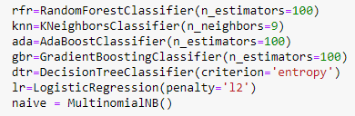
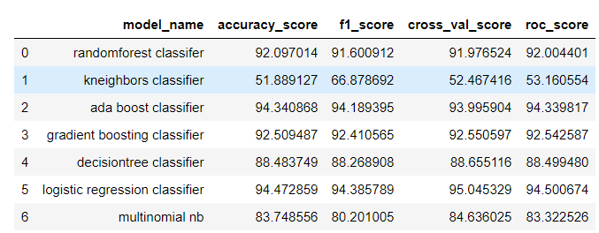
Models used and result :

Slide 10
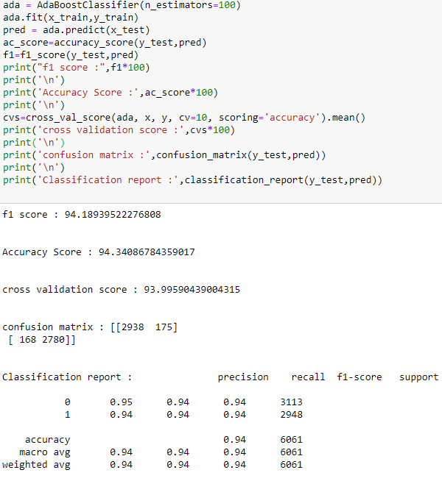
# Ada boost classifier giving best results amongst all algorithms :
An Ada Boost classifier is a meta-estimator that begins by fitting a classifier on the original dataset and then fits additional copies of the classifier on the same dataset but where the weights of incorrectly classified instances are adjusted such that subsequent classifiers focus more on difficult cases
Ada Boost is an iterative ensemble method. Ada Boost classifier builds a strong classifier by combining multiple poorly performing classifiers so that you will get high accuracy strong classifier. The basic concept behind Ada boost is to set the weights of classifiers and training the data sample in each iteration such that it ensures the accurate predictions of unusual observations

Slide 11
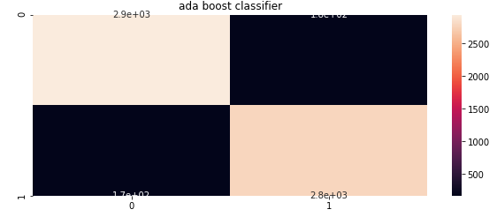
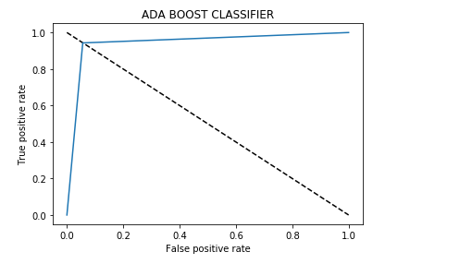
Most of area is lying under the curve and providing the high true positive rate approx. 94% which is good sign of better prediction

Slide 12
Conclusion :
There are various aspect of the dataset and observation from my point of view :
There are more than 60% news that are real.
Most of the real news are containing words followed by election, president etc.
Removing the column that are unnamed ,id , written_by , headline does not impact the model training.
Also, using Tfidf vectorizer along with hyper parameter tuning reduce the false positive error.
Using the roc-auc-curve most of the region fall under the curve and accuracy is near to 94%.
From multiple model it is shown that Ada boost with Tfidf suit well for the data and have better performance as compared to others models and there is no under/overfitting .

